Slide 1

Chapter 1: Embedded Computing
Embedded System Design

Slide 2


Microprocessor and embedded systems
Computing systems are everywhere
Most of us think of “desktop” computers
PC’s
Laptops
Mainframes
Servers
But a PC is not itself an embedded system
Microprocessor , I/O, Memory
The challenges are not computer engineering

Slide 3
Microprocessor and Embedded systems
Microprocessor overview
programmability
4,8,16,32,64
CISC, RISC
Multiprocessor

Slide 4
Embedded systems overview
Embedded computing systems
Computing systems embedded within electronic devices
Hard to define. Nearly any computing system other than a desktop computer
Billions of units produced yearly, versus millions of desktop units
Perhaps 50 per household and per automobile
Computers are in here...
and here...
and even here...
Lots more of these, though they cost a lot less each.

Slide 5
A “short list” of embedded systems
Anti-lock brakes
Auto-focus cameras
Automatic teller machines
Automatic toll systems
Automatic transmission
Avionic systems
Battery chargers
Camcorders
Cell phones
Cell-phone base stations
Cordless phones
Cruise control
Curbside check-in systems
Digital cameras
Disk drives
Electronic card readers
Electronic instruments
Electronic toys/games
Factory control
Fax machines
Fingerprint identifiers
Home security systems
Life-support systems
Medical testing systems
Modems
MPEG decoders
Network cards
Network switches/routers
On-board navigation
Pagers
Photocopiers
Point-of-sale systems
Portable video games
Printers
Satellite phones
Scanners
Smart ovens/dishwashers
Speech recognizers
Stereo systems
Teleconferencing systems
Televisions
Temperature controllers
Theft tracking systems
TV set-top boxes
VCR’s, DVD players
Video game consoles
Video phones
Washers and dryers

Slide 6
Definition of Embedded Systems
Embedded system: is a system whose principal function is not computational, but which is controlled by a computer embedded within it.
6

Slide 7
characteristics of embedded systems
Single-functioned
Executes a single program, repeatedly
Tightly-constrained
Low cost, low power, small, fast, etc.
Reactive and real-time
Continually reacts to changes in the system’s environment
Must compute certain results in real-time without delay

Slide 8
Performance of embedded systems —real-time
CPU
SPEC, Multiprocessor,Multicore
Platform
BUS, Memory, I/O device, etc.
Program
Structure
Task
Scheduling

Slide 9
Design metrics
Obvious design goal:
Construct an implementation with desired functionality
Key design challenge:
Simultaneously optimize numerous design metrics
Design metric
A measurable feature of a system’s implementation
Optimizing design metrics is a key challenge

Slide 10
Design metrics
Common metrics
Unit cost: the monetary cost of manufacturing each copy of the system, excluding NRE cost
NRE cost (Non-Recurring Engineering cost): The one-time monetary cost of designing the system
Size: the physical space required by the system
Performance: the execution time or throughput of the system
Power: the amount of power consumed by the system
Flexibility: the ability to change the functionality of the system without incurring heavy NRE cost

Slide 11
Design metrics
Common metrics (continued)
Time-to-prototype: the time needed to build a working version of the system
Time-to-market: the time required to develop a system to the point that it can be released and sold to customers
Maintainability: the ability to modify the system after its initial release
Correctness, safety, many more

Slide 12
Design process
Top-down / Bottom-up
Requirements
Specification
Architecture
Components
System integration

Slide 13
Design metric competition
Expertise with both software and hardware is needed to optimize design metrics
Not just a hardware or software expert, as is common
A designer must be comfortable with various technologies in order to choose the best for a given application and constraints
Power
Performance
Size
NRE cost
CCD
Digital camera chip
A2D
CCD preprocessor
Pixel coprocessor
D2A
lens
JPEG codec
Microcontroller
Multiplier/Accum
DMA controller
Display ctrl
Hardware
Software
Memory controller
ISA bus interface
UART
LCD ctrl

Slide 14
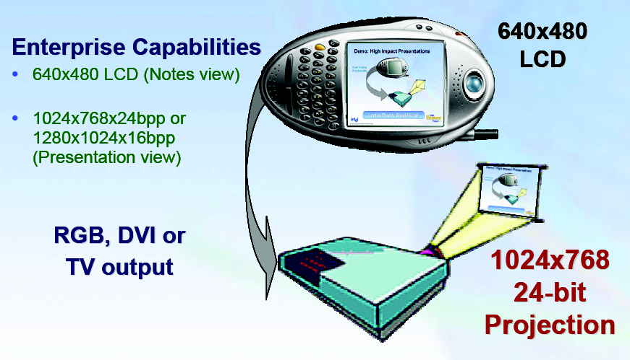
Intel 2700G appliation–High Impact Presentation

Slide 15

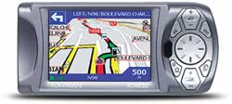
Navman iCN 630
The TFT automotive rated LCD 3.8" QVGA 320 x 240 resolution screen has more than 65,000 colours displaying maps with unprecedented clarity.
3D map views give the best perspective for the street ahead, a real help for when navigating ahead.

Slide 16
NRE and unit cost metrics
Costs:
Unit cost: the monetary cost of manufacturing each copy of the system, excluding NRE cost
NRE cost (Non-Recurring Engineering cost): The one-time monetary cost of designing the system
total cost = NRE cost + unit cost * # of units
per-product cost = total cost / # of units
= (NRE cost / # of units) + unit cost

Slide 17
Three key embedded system technologies
Technology
A manner of accomplishing a task, especially using technical processes, methods, or knowledge
Three key technologies for embedded systems
Processor technology
IC technology
Design technology

Slide 18
General-purpose processors
Programmable device used in a variety of applications
Also known as “microprocessor”
Features
Program memory
General datapath with large register file and general ALU
User benefits
Low time-to-market and NRE costs
High flexibility
“Pentium” the most well-known, but there are hundreds of others
Controller
Datapath
Control
logic and State register
Register
file
General
ALU
IR
PC
Program memory
Data
memory
Assembly code for:
total = 0
for i =1 to …

Slide 19
Single-purpose processors
Digital circuit designed to execute exactly one program
a.k.a. coprocessor, accelerator or peripheral
Features
Contains only the components needed to execute a single program
No program memory
Benefits
Fast
Low power
Small size
Controller
Datapath
Control logic
index
total
State register
+
Data
memory

Slide 20
Application-specific processors
Programmable processor optimized for a particular class of applications having common characteristics
Compromise between general-purpose and single-purpose processors
Features
Program memory
Optimized datapath
Special functional units
Benefits
Some flexibility, good performance, size and power
Controller
Datapath
Control
logic and State register
Registers
Custom
ALU
IR
PC
Data
memory
Program memory
Assembly code for:
total = 0
for i =1 to …

Slide 21
The co-design ladder
In the past:
Hardware and software design technologies were very different
Recent maturation of synthesis enables a unified view of hardware and software
Hardware/software “codesign”
Sequential program code (e.g., C, VHDL)
Compilers
(1960's,1970's)
Behavioral synthesis
(1990's)
Register transfers
Assembly instructions
RT synthesis
(1980's, 1990's)
Assemblers, linkers
(1950's, 1960's)
Logic equations / FSM's
Logic synthesis
(1970's, 1980's)
Machine instructions
Logic gates
Implementation
Microprocessor plus program bits: “software”
VLSI, ASIC, or PLD implementation: “hardware”
The choice of hardware versus software for a particular function is simply a tradeoff among various design metrics, like performance, power, size, NRE cost, and especially flexibility; there is no fundamental difference between what hardware or software can implement.

Slide 22
Homework
Why not use PCs for all Embedded computing？P7/P5
The major goals of the embedded system design? P12
多校区售饭系统
存在问题
网络架构
通信方式

